Slide 1
SAPUI5
Adrian Streitz, Johannes Rank, Borys Levkovskyi

Slide 2
Prerequisites
Fundamental programming skills
Successful completion of the chapter Introduction to SAP Application Development
Recommended: Completion of the chapter HTML5, CSS & JavaScript

Slide 3
Agenda
Fundamentals
Creating and implementing SAPUI5 applications
Model-View-Controller
Modularization & Navigation
Debugging SAPUI5 applications

Slide 4
I. Fundamentals SAPUI5
Toolkit for developing client applications for mobile and desktop platforms
Based on HTML5, JavaScript, jQuery and the Model-View-Controller (MVC) concept
Contains a large library of simple and complex UI controls
Allows to create flexible and portable applications
SAPUI5 applications can be run on several platforms (SAP NetWeaver AS ABAP, SAP HANA Cloud Platform, SAP Mobile Platform)

Slide 5
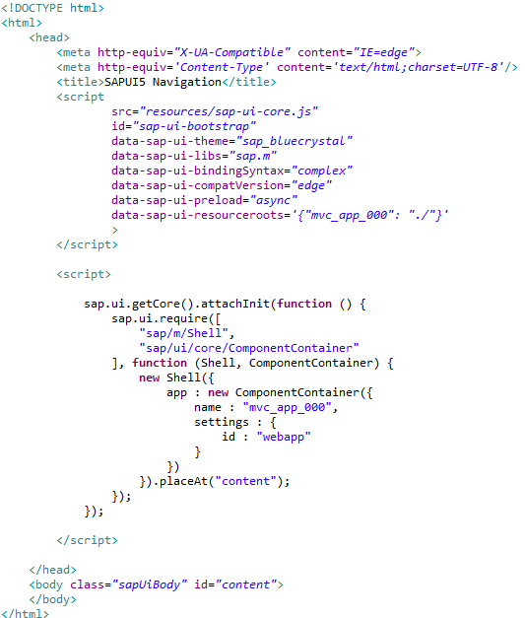
I. Fundamentals Anatomy of an SAPUI5 application
SAPUI5 applications consist of view/controller pairs which define layout and logic of the application
Every application has an initial view/controller pair
Central index.html file consisting of the following sections:
Theme definition and including of the SAPUI5 libraries
Component Container instantiation
Id for the <body>, into which the application will be embedded
Including themes and libraries
Namespace Definition
Instantiating a Component Container
Default content section

Slide 6
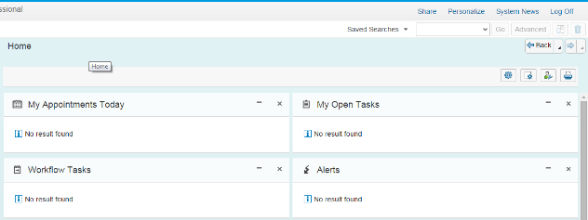
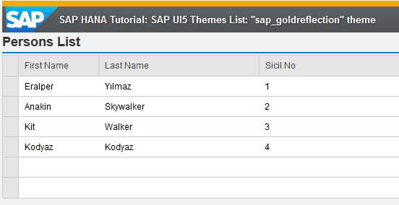
II. Creating and implementing SAPUI5 applications Index.html
Main entry point for every SAPUI5 Application
Meta information: document mode, charset
Bootstrap: application runtime configuration
src: path to UI5 source files (local or CDN)
theme: defines the application appearance (bluecrystal, gold reflection, etc)
libs: sap.m or sap.ui.commons
bindingSyntax: deterines the syntax for the data binding in the XML views - default or complex; complex should be used since the 1.28 version
compatVersion: set to edge to assure the most recent functionality of UI5
preload: async - UI5 resources loaded simultaneously in the background
Meta information
Bootstrap
Notes:
SAPUI5 ist in mehrere Bibliotheken organisiert sap.m / sap.commons

Slide 7
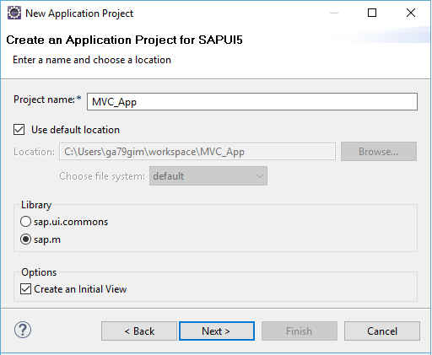
II. Creating and implementing SAPUI5 applications Step 1: Create a new SAPUI5 application project
In the Project Explorer, choose New -> Other -> SAPUI5 Application Development -> Application Project
It is recommended to create an initial view
You can choose between different formats for your initial view
Creating an initial view automatically creates a controller for this view

Slide 8
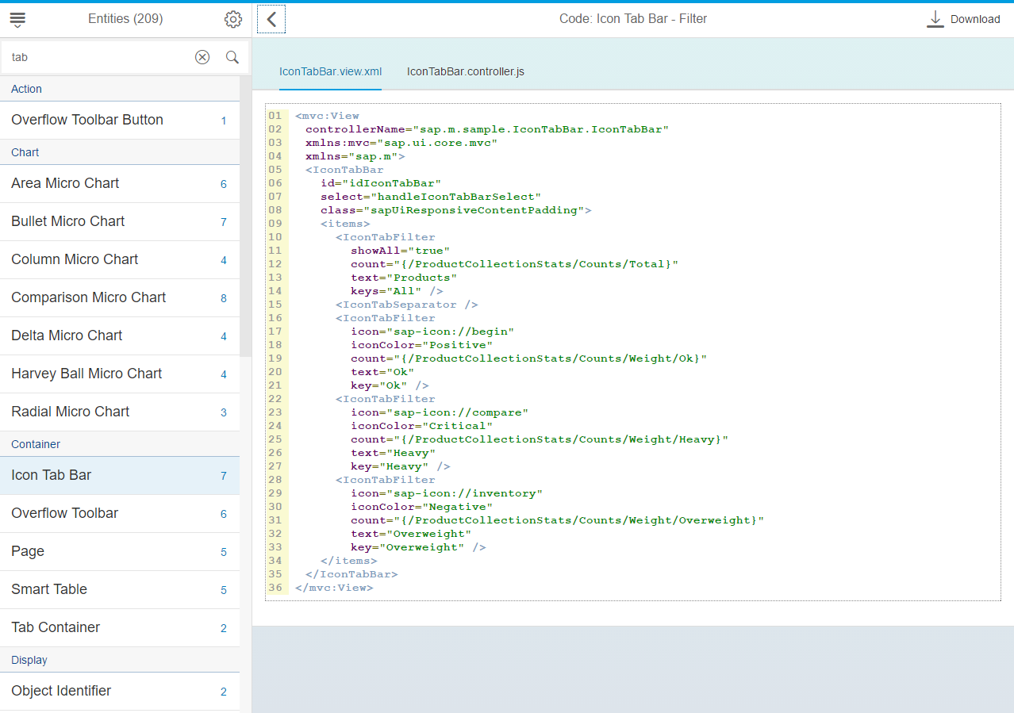
II. Creating and implementing SAPUI5 applications Step 2: Implement view-controller pairs
View and controller are always implemented together
The view defines the layout elements, while the controller defines the logic and event handling for the view
SAPUI5 has a huge library of predefined view elements which can be used for the implementation
A huge collection of code examples for the different view elements can be accessed via https://sapui5.hana.ondemand.com/

Slide 9
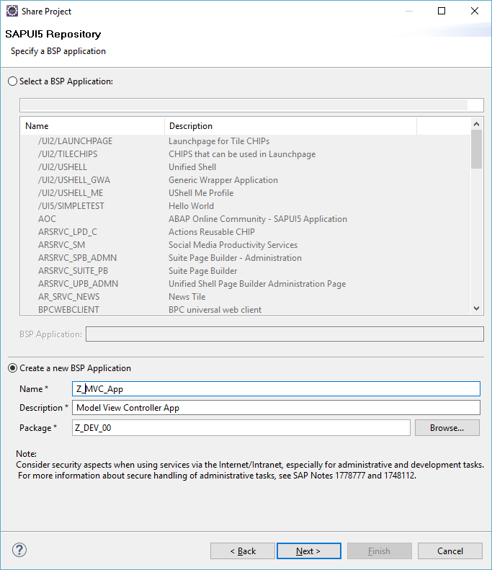
II. Creating and implementing SAPUI5 applications Step 3: Deploy the application in the SAP backend
In the Project Explorer, choose with a right click Team -> Share Project
Choose the SAPUI5 ABAP Repository as repository object
Connect to the SAP system to which you want to deploy the application
Create a new BSP application as container for your SAPUI5 implementation
You can repeatedly submit implementation changes to the SAP backend via Team -> Submit

Slide 10
III. Model-View-Controller Architectural pattern
Model:
Manages data and connections to data sources
Holds application data
View:
Creates user interface
Passes user actions to a separate controller
Controller:
Contains control logic
Manages interaction between view and model
Communicates with the model if a user action evokes data operations

Slide 11
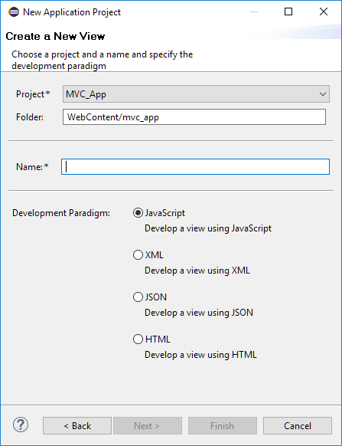
III. Model-View-Controller View types
Views
Views can be implemented in different forms:
JavaScript: sap.ui.core.mvc.JSView
XML: sap.ui.core.mvc.XMLView
JSON: sap.ui.core.mvc.JSONView
HTML: sap.ui.core.mvc.HTMLView
Creating views using XML has several advantages:
Clearer implementation
XML can be checked and validated easier
SAP Fiori is completely based on XML views

Slide 12
Now you know the fundamentals of SAPUI5 applications.
To consolidate your knowledge, you can do task 1, 2 and 3 of the SAPUI5 exercise.

Slide 13
III. Model-View-Controller Architectural pattern
Model
Controller 1
Controller 2
View 1
View 2

Slide 14
III. Model-View-Controller SAP UI5 Architecture
Model(s)
Main Controller
Controller X
Main View
View X
View 1
Index.html

Slide 15
III. Model-View-Controller The Model
Represents the data layer and refers to the source of the application data
Offers a possibility to access data with the common CRUD operations (create, read, update and delete)
Often also known as publisher
Predefined models:
JSON model (intended for small datasets, client-side)
XML model (intended for small datasets, client-side)
OData model (connection to server-side OData services)

Slide 16
III. Model-View-Controller Architectural pattern in web development
Controller
Update
Notification
User interaction
Update
Model
(JSON, XML, OData)
View
SAP Library

Slide 17

III. Model-View-Controller The Controller
Controllers are always assigned to a specific view
Controllers contain four initial functions:
onInit: Called when the controller is instantiated
onBeforeRendering: Called before the view is rendered
onAfterRendering: Called after the view is rendered
onExit: Called when the controller is destroyed
e.g. validation of control elements

Slide 18
IV. Modularization & Navigation Components
Independent and reusable parts in SAPUI5 applications
Are similar to classes in object-oriented languages
Advantages:
Split application into smaller parts
Can be loaded at runtime, when they are needed
Can be developed independently
Can be nested into one another or embedded into other applications (e.g. FIORI Launchpad)

Slide 19
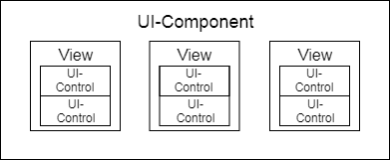
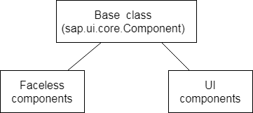
IV. Modularization & Navigation Component-types
Faceless components: Have no user interface, useful for backend-services
UI components: Include multiple views, represent screen elements or areas on the UI

Slide 20
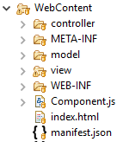
IV. Modularization & Navigation Component structure
Organized in unique namespace (all required and optional resources have to be organized in the namespace of the component)
Consists of a component controller (Component.js, mandatory) and a descriptor (manifest.json)
Component.js: provides the runtime metadata and the component methods
Manifest.json: provides metadata, dependencies, configuration settings
Optional: Views, controller, …

Slide 21
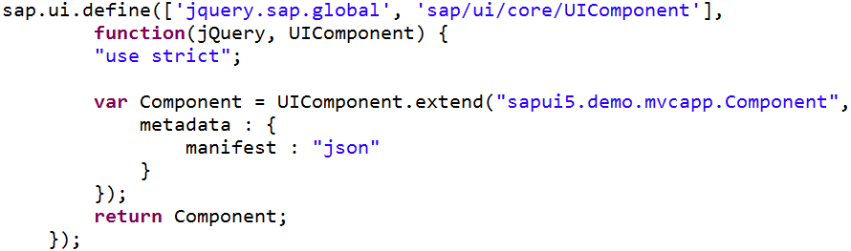
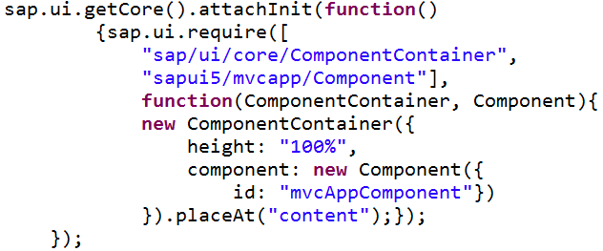
IV. Modularization & Navigation Include (UI-)component in application
index.html
To render UI-components they have to be wrapped in a component container
Component container:
Separates the application and the nested component
Can contain multiple components
Carries specific settings and contains the lifecycle methods of a regular control (onBeforeRendering and onAfterRendering methods)
namespace
Component.js

Slide 22
IV. Modularization & Navigation Navigation
Navigation in sapui5
Shell based navigation
Event bus (asynchronous subscribe/publish mechanism, JavaScript events)
Routing (based on crossroads.js)
Intra-application navigation
Bookmark/ resume UI states
Event bus:
Communicate between active controllers
Listens to every event
Router:
Communicate between targets (e.g. view 1 and view 2)
Listens only to browser url hash changes

Slide 23
IV. Modularization & Navigation Routing
Advantages of routing (hash-based navigation):
Use browser navigation to navigate between states and views
Bookmark deep links and program states (even a specific search)
Pass on data via the hash

Slide 24
IV. Modularization & Navigation Routing
Traditional Web applications:
server serves requested resources based on the URL pattern
The server-side logic controls how the requested resource or page is displayed
Single-page applications:
Only one page is initially requested from the server
Additional resources are dynamically loaded using client-side logic
The user only navigates within this page
The navigation is persisted in the hash instead of the server path or URL parameters

Slide 25
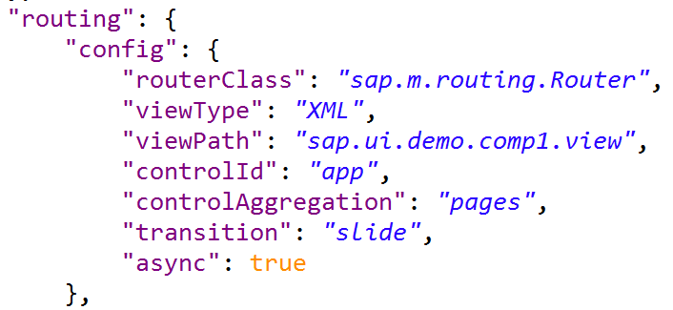
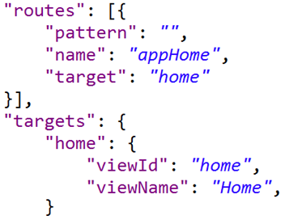
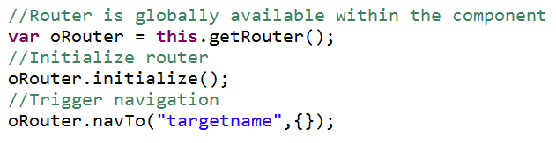
IV. Modularization & Navigation Routing
Config: define global configurations and default values that apply for all routes and targets
Routes: define a name, a pattern and targets to which to navigate when the route has been matched
They can be hard-coded or include optional, mandatory or query parameters
Targets: defines the view that is displayed. Needs target key and view name

Slide 26
Now you know the Model-View-Controller concept of SAPUI5 applications.
To consolidate your knowledge, you can do task 4 and 5 of the SAPUI5 exercise.

Slide 27
V. Debugging SAPUI5 applications Debugging tools in SAPUI5
Debugging is an important task in application development with regard to retracing program code and finding errors
There is no central tool to debug SAPUI5 applications because they can be run on different platforms
It is recommended to use developer tools of the browser to debug SAPUI5 applications
Every modern web browser (e.g. Google Chrome, Mozilla Firefox, Internet Explorer) has an integrated debugger in its developer tools

Slide 28
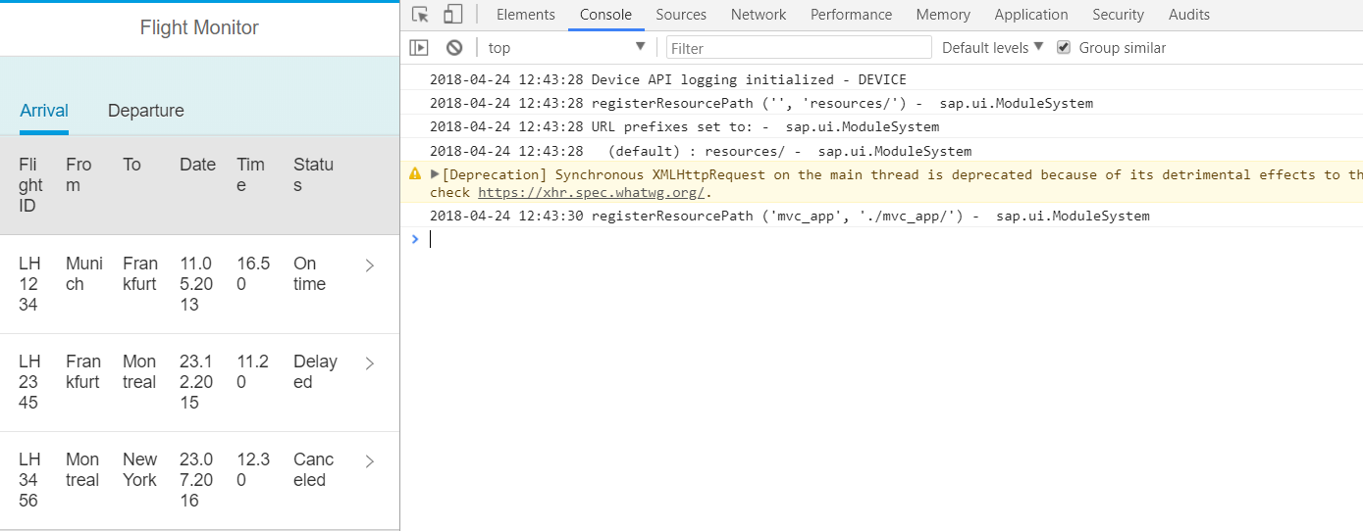
IV. Debugging SAPUI5 applications Debugging process in SAPUI5
The console is a central tool to find strong program errors (e.g. syntax errors)

Slide 29
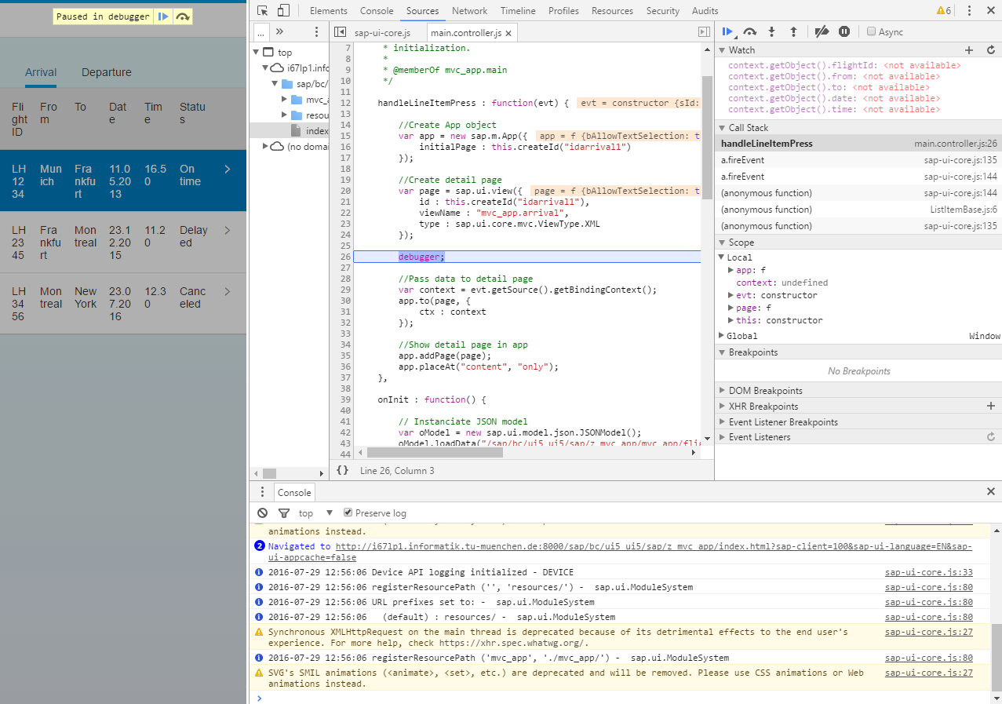
V. Debugging SAPUI5 applications Debugging process in SAPUI5
The console is a central tool to find strong program errors (e.g. syntax errors)
Setting breakpoints can help you to retrace the program execution and variable values at certain points in the program
Always make use of the debugger if you want to know more about your implemented program logic

Slide 30
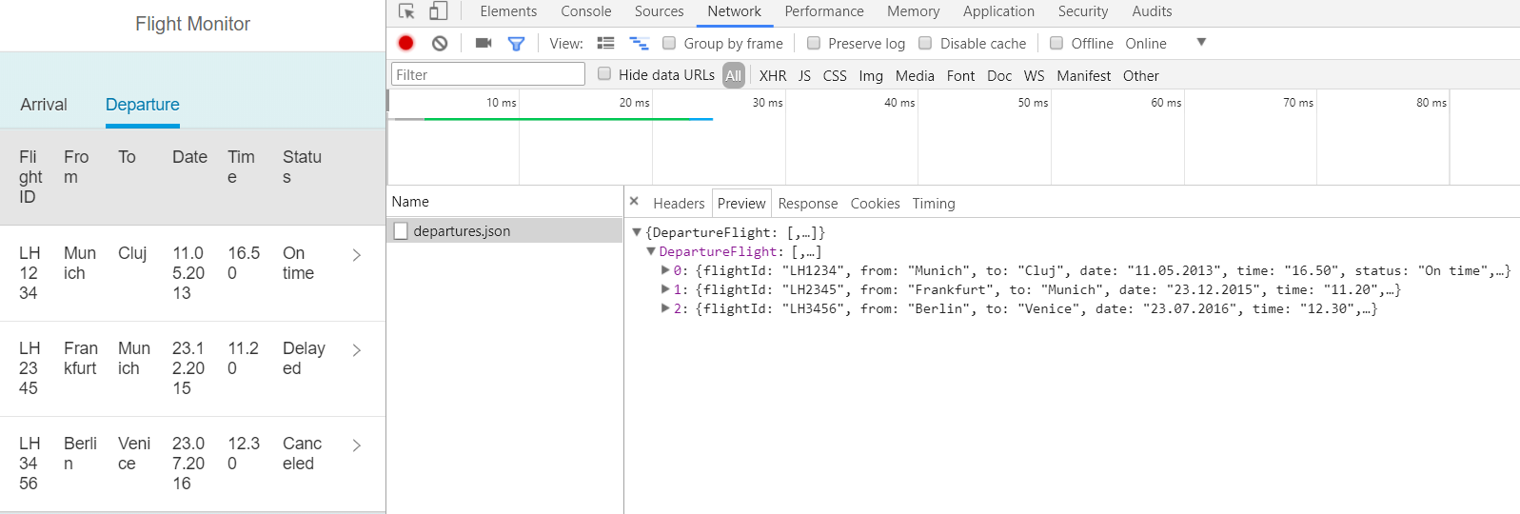
IV. Debugging SAPUI5 applications Debugging process in SAPUI5
The tab Network provides you with information about the requested data
Have a look on it in case you have troubles with your data model

Slide 31
Now you know how to debug SAPUI5 applications.
To consolidate your knowledge, you can do task 6 of the SAPUI5 exercise.

Slide 32
Check your knowledge

Slide 33
Check your knowledge
The index.html file has to be modified in order to show an initial view.
□ True □ False
Which statement(s) about the Model-View-Controller concept is/are correct?
□ Models are created within a controller
□ Models can be directly assigned to views
□ Controllers pass the model to the view
With which programming languages can model, view and controller be implemented within an SAPUI5 application?
A text field in your application is empty although you created a reference to a data element. How would you debug your application to find out the reason for this?

Slide 34
Solution

Slide 35
Solution
The index.html file has to be modified in order to show an initial view.
□ True ☒ False
Which statement(s) about the Model-View-Controller concept is/are correct?
☒ Models are created within a controller
□ Models are directly referenced within views
☒ Controllers pass the model to the view
With which programming languages can model, view and controller be implemented within an SAPUI5 application?
See section Creating and implementing SAPUI5 applications
A text field in your application is empty although you created a reference to a data element. How would you debug your application to find out the reason for this?
See section Debugging SAPUI5 applications

Slide 36
References
Antolovic, M.: (2016): Einführung in SAPUI5, SAP PRESS 2016

